Slide 1

Personalizing ATS for Persons with Cognitive Impairments using DPO
Colloquium 27.05
Kaede Johnson
12.05.2024

Slide 2
Motivation & RQs
Personalizing ATS for Persons with Cognitive Impairments using DPO
Simplify this sentence: “All happy families are alike; each unhappy family is unhappy in its own way.”

Slide 3
Motivation & RQs
Personalizing ATS for Persons with Cognitive Impairments using DPO
automatic text simplification
Prompt
Simplify this sentence: “All happy families are alike; each unhappy family is unhappy in its own way.”
ChatGPT Responses
Happy families are alike, but unhappy families are different.
Happy families have similar lives. Unhappy families each have their own struggles.
<many more>

Slide 4
Motivation & RQs
Personalizing ATS for Persons with Cognitive Impairments using DPO
“the target group”
Typically not:
… consulted during AI development
… chosen for ATS personalization
… equipped with proper feedback tools

Slide 5
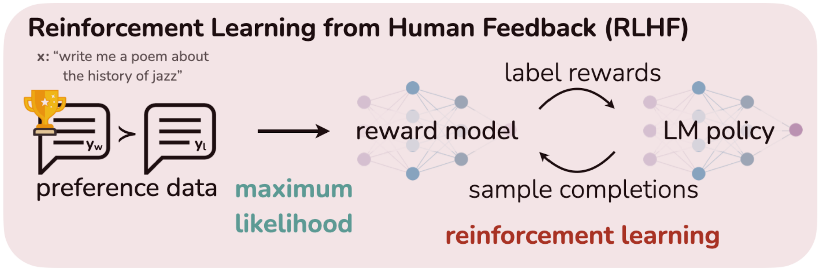
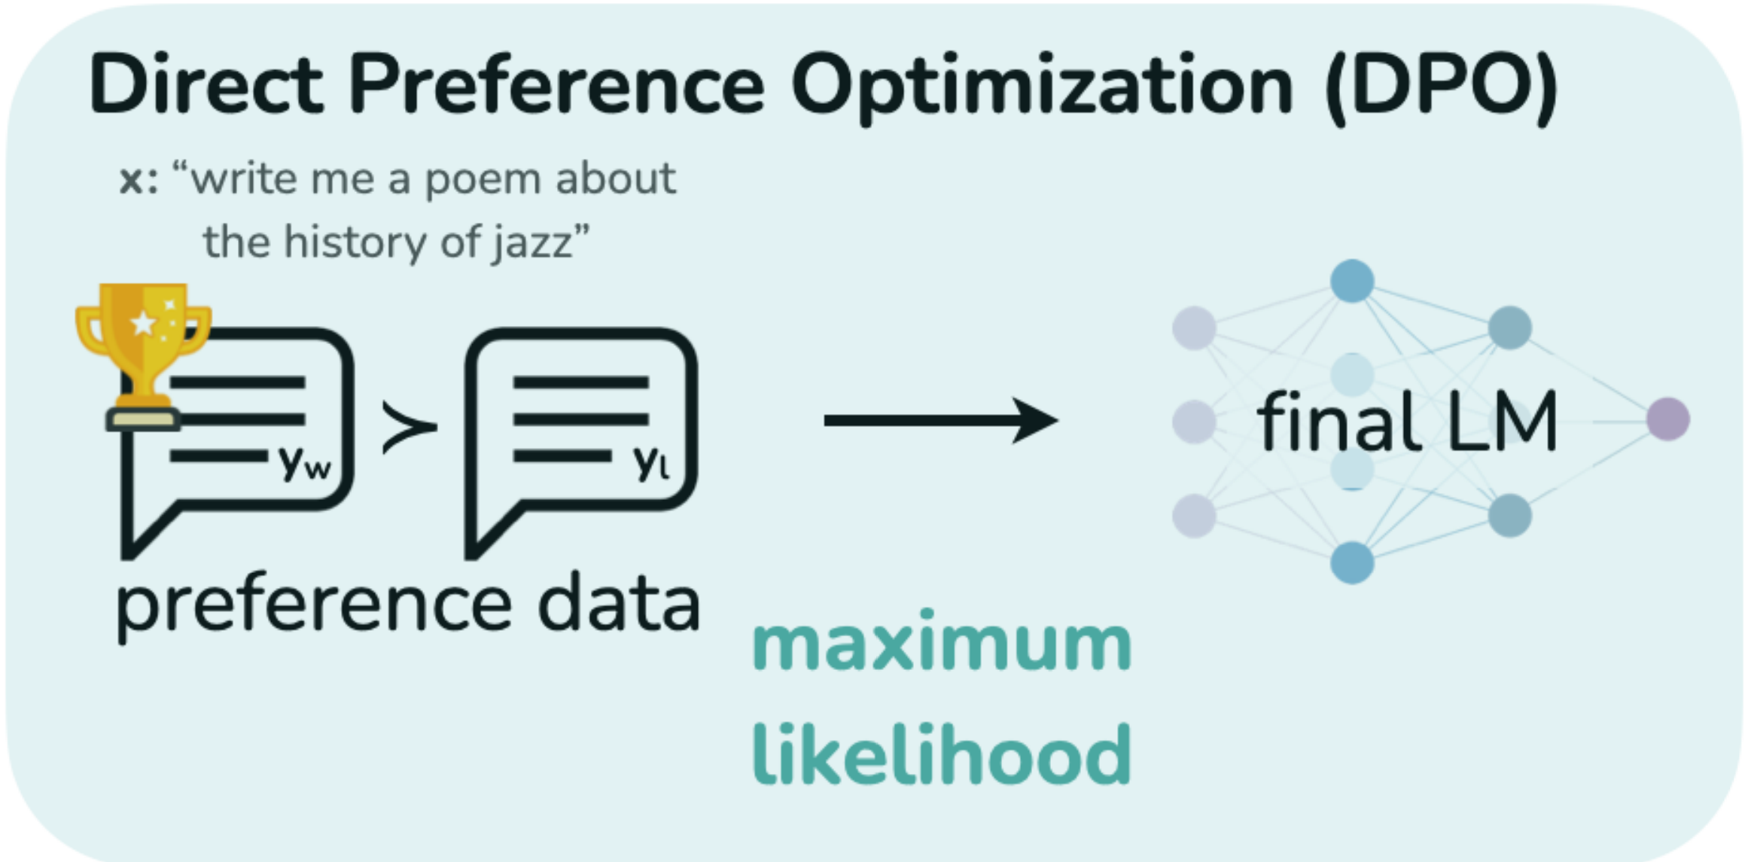
Motivation & RQs
Personalizing ATS for Persons with Cognitive Impairments using DPO
Personalizing ATS for Persons with Cognitive Impairments using DPO
direct preference optimization
DPO removes the external reward model!
Rafailov, Rafael, et al. 2024

Slide 6
Motivation & RQs
Personalizing ATS for Persons with Cognitive Impairments using DPO
Personalizing ATS for Persons with Cognitive Impairments using DPO
Using human preferences to make an LLM
simplify text in a way more suitable for the target group.

Slide 7
Motivation & RQs
Personalizing ATS for Persons with Cognitive Impairments using DPO
Research Questions
Can DPO improve ATS according to automatic metrics?
Which factors affect DPO’s efficacy?
Can DPO enable group-level personalization of ATS?

Slide 8
Implementation
SFT
Pair Creation
Pair Annotation
DPO

Slide 9




Implementation
SFT
Models
Prompts
“Disco Llama”
Mention target group,
Leichte Sprache,
simplification approaches.
Mostly zero-shot, some one-
and two-shot.
Developed with expert at ZHAW.
10 total (8 used again in DPO)
Pair Creation
“Llama”
Pair Annotation
“LeoLM Mistral”
“Mistral”
DPO
7-8B Params, Instruct, Common

Slide 10
Implementation
SFT
Data: DEplain-APA
Pair Creation
B1
A2
📄📃
Complex: ‘Am Mittwoch hat der Iran bekanntgegeben, dass er teilweise
aus dem Atom-Abkommen aussteigt.’
(en: On Wednesday, Iran announced that it was
partially withdrawing from the nuclear agreement.)
👤
Pair Annotation
News items
Manually written, manually aligned
(Austrian) German
Topics: elections, coronavirus,
crime, zoo births, etc.
DPO
Simple: ‘Der Iran wird teilweise aus dem Atom-Abkommen aussteigen.’
(en: Iran will partially withdraw
from the nuclear agreement.)

Slide 11
Implementation
➡️
SFT
Data Issues & Preprocessing
Pair Creation
C: ‘Integration bedeutet, also dass jemand dazugehört.’
Too similar! Apply Rouge F1 upper bound
S: ‘Integration bedeutet also, dass jemand dazugehört.’
(en: integration means that someone belongs)
➡️
Pair Annotation
C: ‘Es gibt aber große Unterschiede.’
(en: But there are big differences)
Lacks entailment! Apply cosine sim. lower bound
➡️
S: ‘Nicht in jedem Vanille-Eis ist gleich viel Luft drin.’
(en: Not every vanilla ice cream contains the same amount of air.)
DPO
We also prioritized longer sentences when sampling for SFT

Slide 12
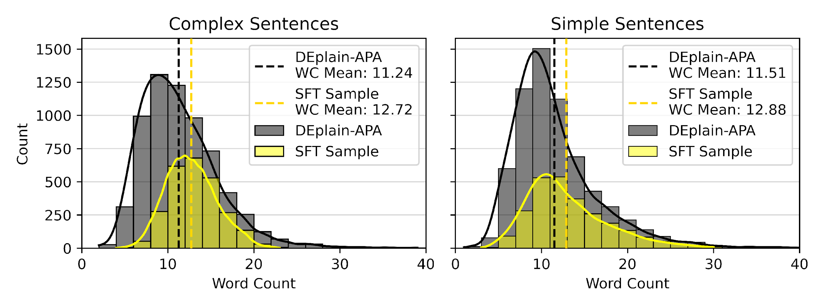
Implementation
➡️
SFT
Data Issues & Preprocessing
Pair Creation
C: ‘Integration bedeutet, also dass jemand dazugehört.’
Too similar! Apply Rouge F1 upper bound
S: ‘Integration bedeutet also, dass jemand dazugehört.’
(en: integration means that someone belongs)
➡️
Pair Annotation
C: ‘Es gibt aber große Unterschiede.’
(en: But there are big differences)
Lacks entailment! Apply cosine sim. lower bound
➡️
S: ‘Nicht in jedem Vanille-Eis ist gleich viel Luft drin.’
(en: Not every vanilla ice cream contains the same amount of air.)
DPO
➡️
Short sentences!
Weight longer sentences
higher when sampling
for SFT

Slide 13
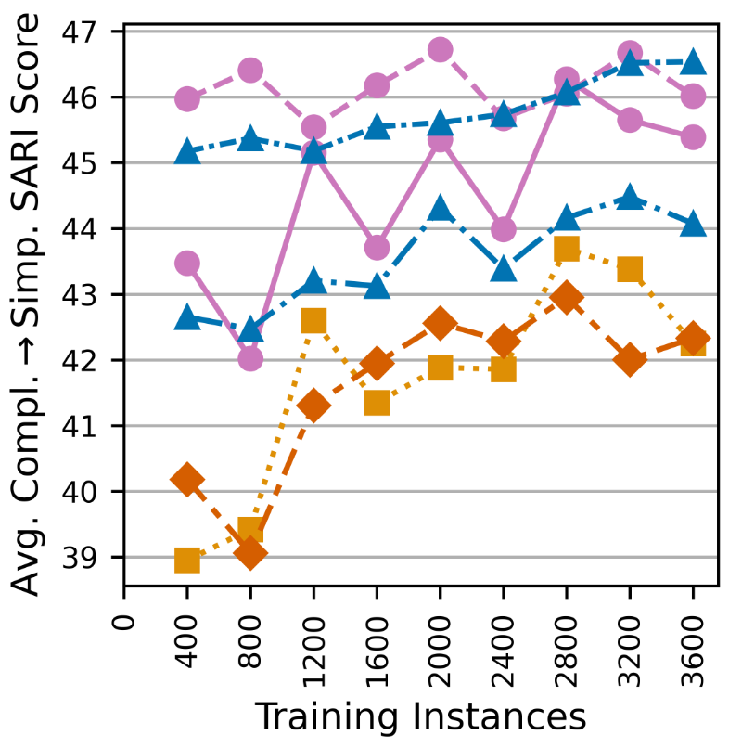
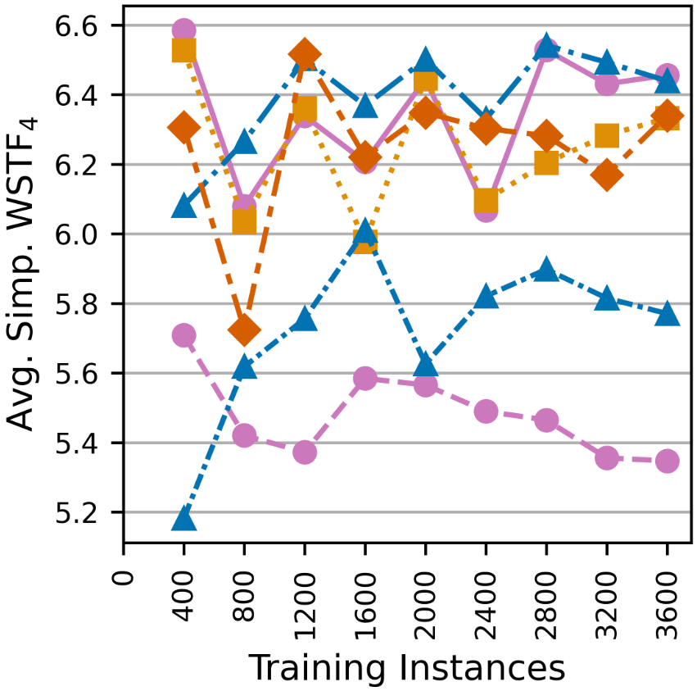
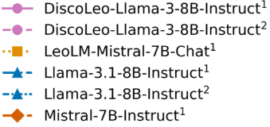
Implementation
SFT
Results
¹
²
¹
Pair Creation
Three checkpoints selected: (2.8K), (2.4K), (1.6K)
SARI
(compl. to simple)
WSTF₄
(simple)
Pair Annotation
Other metrics considered:
BERTScore, BLEU, Word Count,
Flesch, Mirror Rate, Loss
DPO
Winning Checkpoint
¹ Full-prompt loss
² Completion-only loss

Slide 14
Implementation
SFT
¹
Pair Creation
(2.8K)
“SFT Disco Llama”
²
Pair Annotation
(2.4K)
“SFT Llama”
¹
DPO
(1.6K)
“SFT LeoLM Mistral”
¹ Full-prompt loss
² Completion-only loss

Slide 15
Implementation
SFT
Pair Creation
“SFT Disco Llama” had high SARI
Pair Annotation
“SFT LeoLM Mistral” had low WSTF₄
DPO
“SFT Llama” had both high SARI and low WSTF₄ but was verbose
We created pairs and conducted experiments with all three

Slide 16
Implementation
SFT
What is an ATS preference pair?
(x, y_{w}, y_{l})
Pair Creation
Pair Annotation
Complex sentence
‘Losing’ Automatic
Simplification
‘Winning’
Automatic
Simplification
DPO

Slide 17
Implementation
SFT
Inference Input (x)
Pair Creation
B1
A2
📄📃
DEplain-APA
👤
Pair Annotation
DPO
B2+
A2
📄📃
LHA-APA
🤖

Slide 18
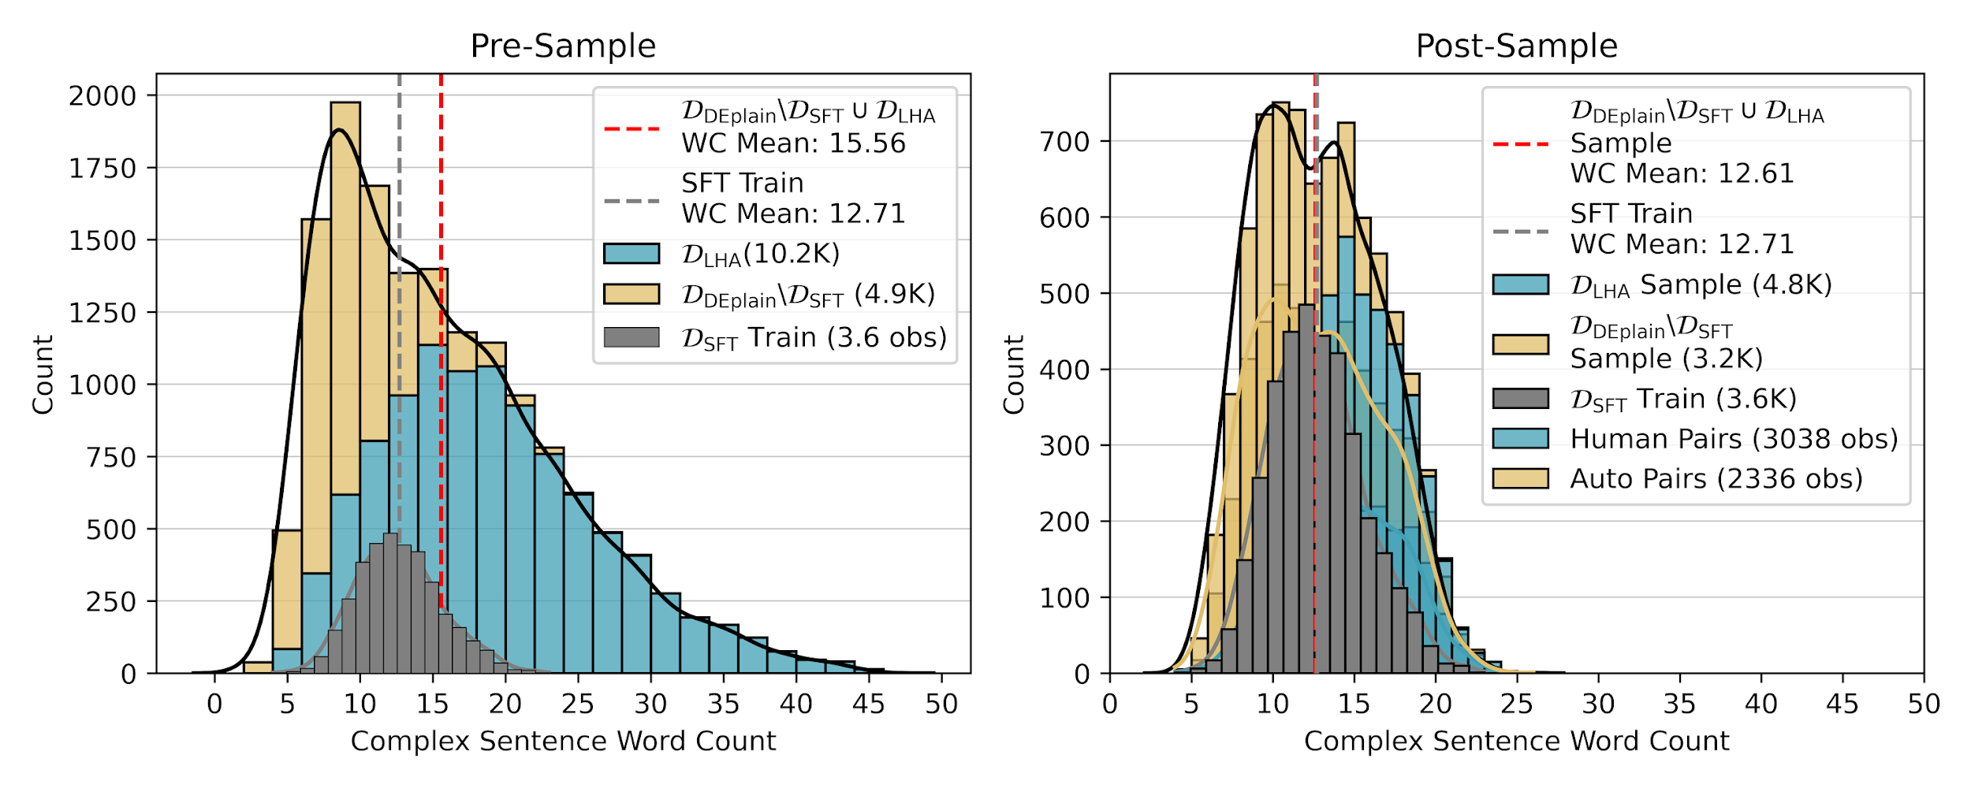
Implementation
SFT
Inference Input (x)
Pre-Sample
Pair Creation
B1
A2
📄📃
DEplain-APA
👤
Pair Annotation
Sample
DPO
B2+
A2
📄📃
LHA-APA
🤖

Slide 19
Implementation
SFT
Inferences (y)
📄
Pair Creation
x
Pair Annotation
DPO
✏️
(y₁, y₂, …, y₂₀)
(y₁, y₂, …, y₂₀)
(y₁, y₂, …, y₂₀)

Slide 20
Implementation
SFT
Inferences (y)
📄
Pair Creation
x
Pair Annotation
👤
(x, y_{A}, y_{B})
DPO
👤
👤
✏️
👤
Criteria: x entails y_{A} and y_{B}
y_{A} and y_{B} have
equal information,
high difference,
high quality
👤
👤
👤
👤
👤
👤
(y₁, y₂, …, y₂₀)
👤
👤
(y₁, y₂, …, y₂₀)
👤
(y₁, y₂, …, y₂₀)

Slide 21
Implementation
SFT
Big thanks to:
Inferences (y)
Lisa Arter
Alessia Battisti
Sophia Conrad
Lukas Fischer
Yingqiang Gao
Patrick Haller
Hanna Hubarava
Annette Rios
Anja Ryser
Patricia Scheurer
Chiara Tschirner
Michelle Wastl
📄
Pair Creation
x
Pair Annotation
👤
(x, y_{A}, y_{B})
DPO
👤
👤
✏️
👤
Criteria: x entails y_{A} and y_{B}
y_{A} and y_{B} have
equal information,
high difference,
high quality
👤
👤
👤
👤
👤
👤
(y₁, y₂, …, y₂₀)
👤
👤
(y₁, y₂, …, y₂₀)
👤
(y₁, y₂, …, y₂₀)

Slide 22
Implementation
SFT
Pair Creation
Created 3,037 (x, y_{a}, y_{b})
Needed to convert into (x, y_{w}, y_{l})
Pair Annotation
DPO

Slide 23
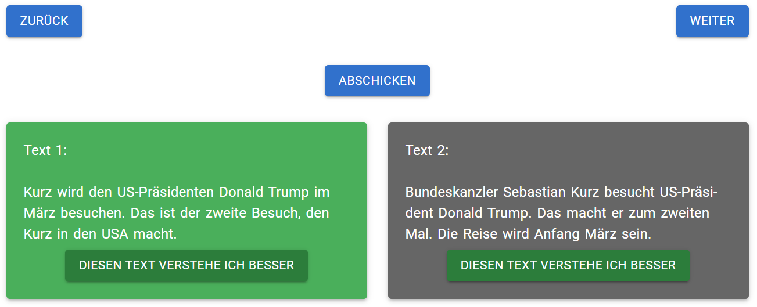
Implementation
SFT
Web Application
Pair Creation
Pair Annotation
DPO
All 3,037 pairs annotated separately by
target group annotators and text simplification experts
Target group annotation sessions organized by capito Austria

Slide 24
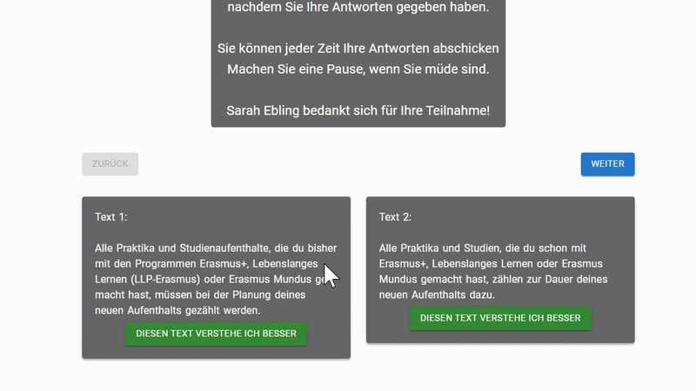
Implementation
SFT
Annotation Resources
Pair Creation
Proctor,
Instruction Sheet,
Informed Consent Form,
€€€
Video Tutorial
Pair Annotation
DPO

Slide 25
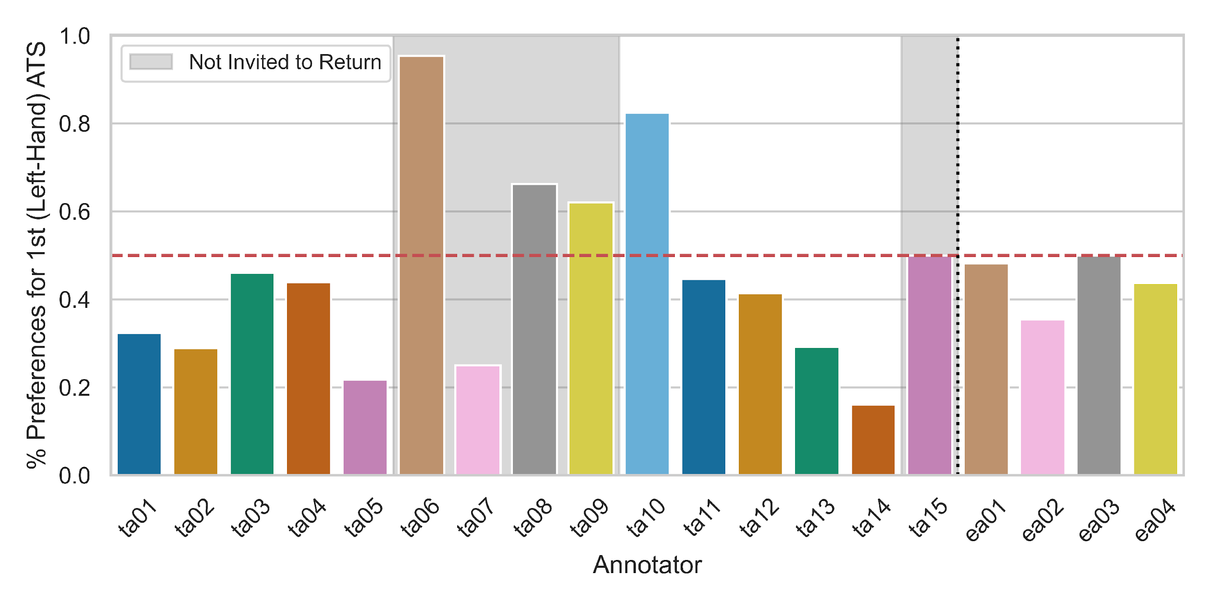
Implementation
SFT
Annotation Behavior
Pair Creation
Pair Annotation
DPO
Issues: concentrating on one side, misunderstanding task, distracting others

Slide 26
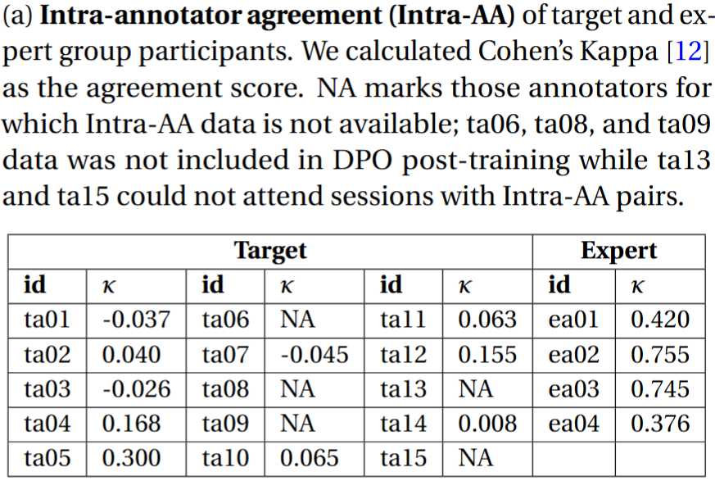
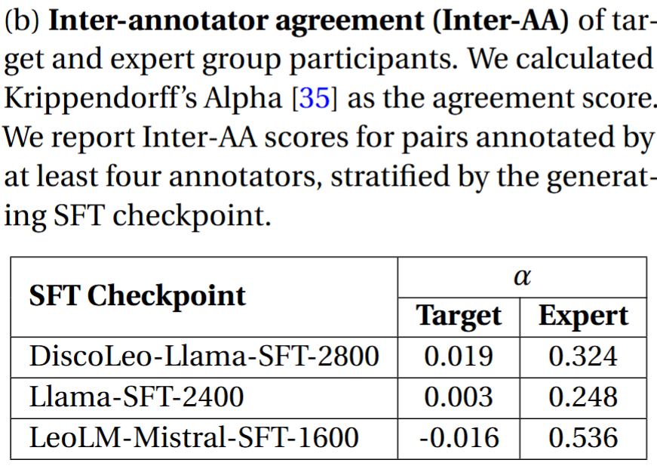
Implementation
SFT
Annotation Agreement
Pair Creation
Pair Annotation
DPO
Target group: little-to-no consistency
Expert group: moderate or strong consistency

Slide 27
Implementation
SFT
Pair Creation
Pair Annotation
(x, y_{w}, y_{l})
complex sentence,
winning simplification,
losing simplification
DPO

Slide 28
Implementation
SFT
y_{w}
y_{l}
“margin”
Pair Creation
DPO
x
x
Pair Annotation
(x, y_{w}, y_{l})
“win” when margin > 0
DPO
complex sentence,
winning simplification,
losing simplification
DPO

Slide 29
Implementation
SFT
Pair Creation
Pair Annotation
(x, y_{w}, y_{l})
complex sentence,
winning simplification,
losing simplification
DPO
Model DPO
is post-training
Pre-DPO
model
Rafailov, Rafael, et al. 2024

Slide 30
Implementation
SFT
Pair Creation
Pair Annotation
(x, y_{w}, y_{l})
The larger this fraction gets,
the better our model is at
generating responses humans prefer
complex sentence,
winning simplification,
losing simplification
DPO
Model DPO
is post-training
Pre-DPO
model
The smaller this fraction gets,
the better our model is at
avoiding responses humans disprefer
Rafailov, Rafael, et al. 2024

Slide 31
Implementation
SFT
Win rate: proportion of times this sum is greater than 0
Pair Creation
Pair Annotation
(x, y_{w}, y_{l})
complex sentence,
winning simplification,
losing simplification
DPO
Model DPO
is post-training
Pre-DPO
model
Rafailov, Rafael, et al. 2024

Slide 32
Implementation
SFT
Pair Creation
Pair Annotation
“DPO …”
“SFT …”
DPO
{Disco Llama , Llama, LeoLM Mistral}

Slide 33
RQ1
Can DPO improve ATS according to automatic metrics?
Experiment:
Implement DPO with all pairs for each preference source (target/expert)
Retain checkpoints that maximize win rates on a development set
Calculate automatic evaluation metrics using DEplain-APA test data

Slide 34
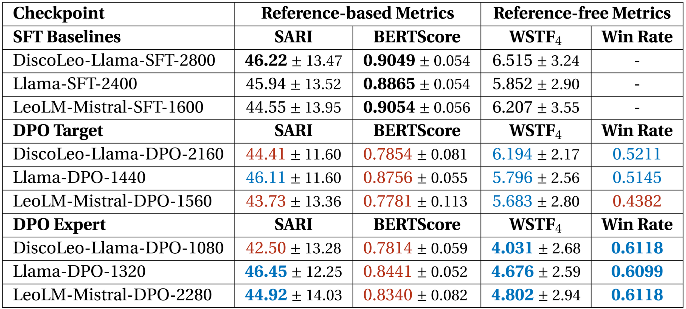
RQ1
Can DPO improve ATS according to automatic metrics?
Dividends in readability, (frequent) costs in meaning preservation.
Expert DPO generally performs better than target DPO;
preference consistency may explain the differential.

Slide 35
RQ2
Which factors affect DPO’s efficacy?
Experiment:
Implement DPO with subsets of all pairs for each preference source
Retain checkpoints that maximize win rates on a development set
Compare win rates of subset checkpoints to global checkpoints

Slide 36
RQ2
Which factors affect DPO’s efficacy?
Subset | Description
All | All pairs (by preference source)
All₌ | Pairs with information equality
LLM₌ | Pairs generated by the SFT checkpoint being post-trained
max. Intra-AA | Pairs from the 4 target or 2 expert annotators with the highest Intra-AA
max. Inter-AA | Pairs from the 4 target or 2 expert annotators with the highest Inter-AA
All_{ex} max. Intra-AA_{tg} | All expert pairs for training, max. Intra-AA target pairs for evaluation

Slide 37
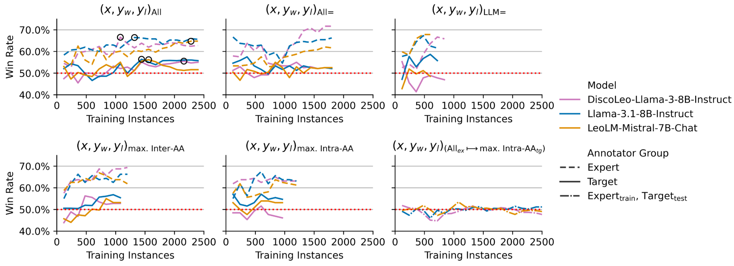
RQ2
Which factors affect DPO’s efficacy?

Slide 38
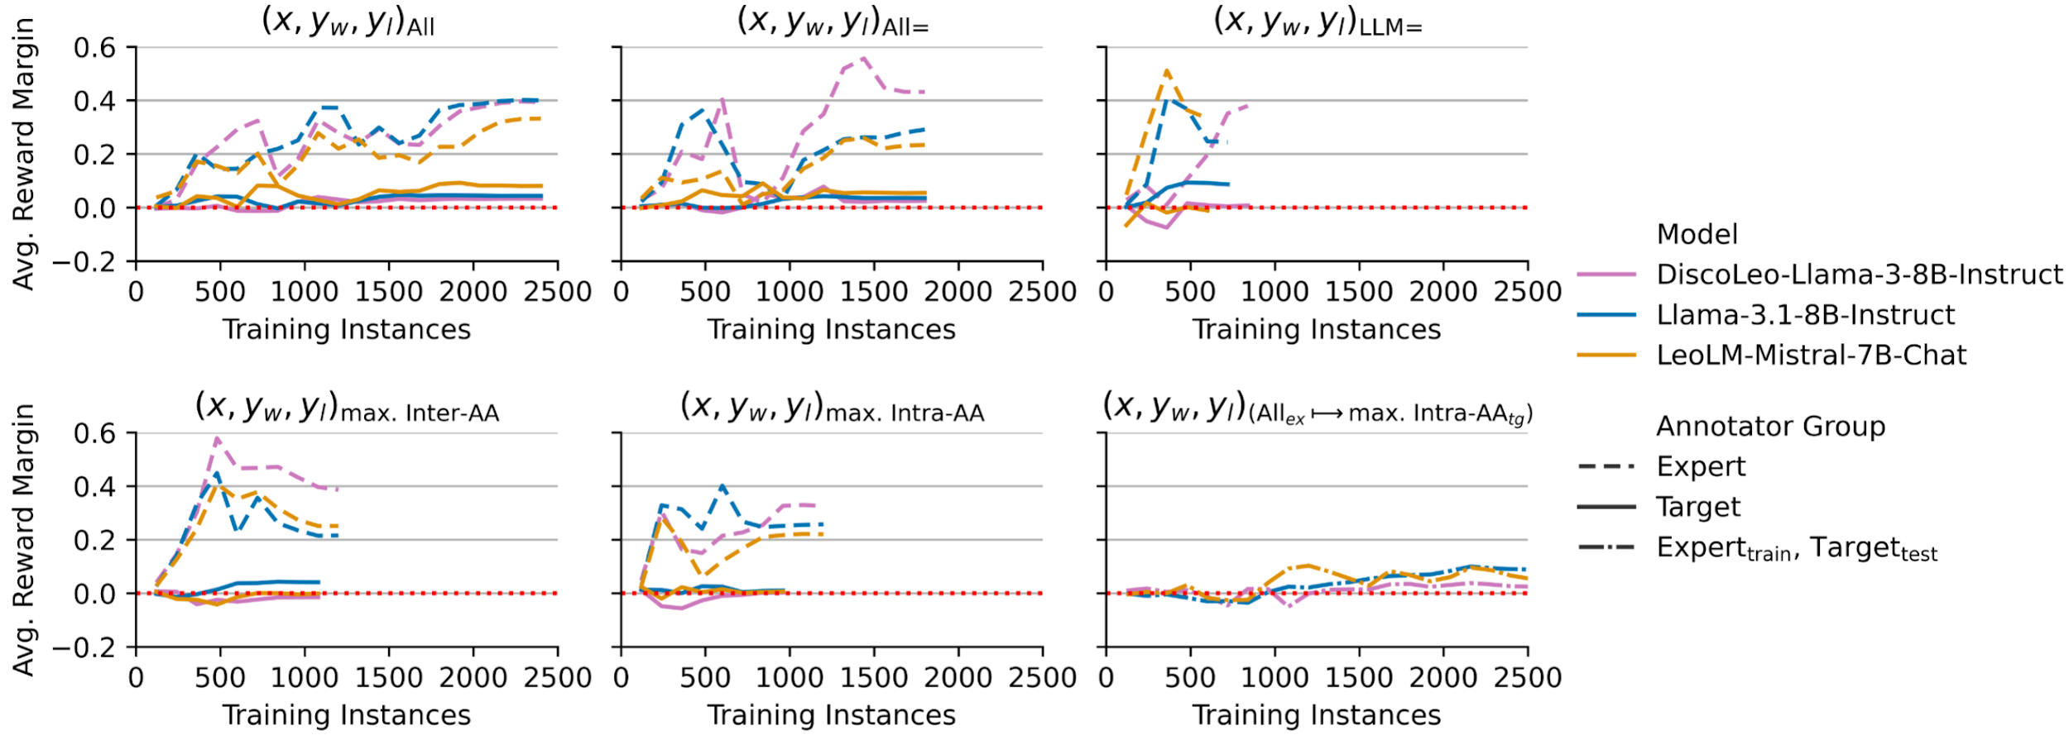
RQ2
Which factors affect DPO’s efficacy?

Slide 39
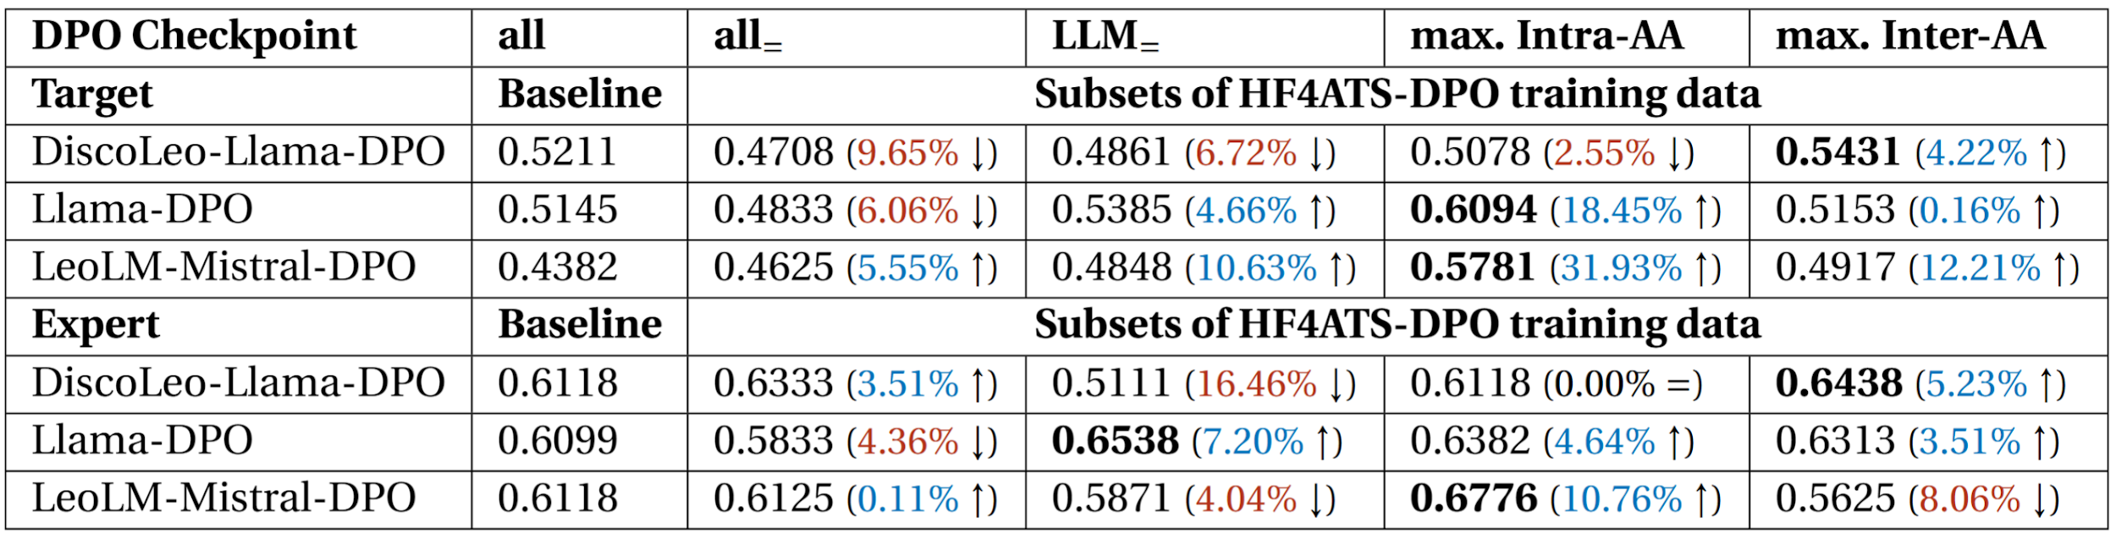
RQ2
Which factors affect DPO’s efficacy?
Preference consistency has a more positive and reliable impact on win rates than (1) information equity or (2) consistency between ATS source and reference model.

Slide 40
RQ3
Can DPO enable group-level personalization of ATS?
Experiment:
Implement DPO with all pairs for each preference source (target/expert)
Using DEplain-APA test sentences, generate new ATS pairs:
Ask humans to indicate their preferences for the new ATS pairs
DPO supremacy: proportion of preferences for DPO inference
(x, y_{SFT}, y_{DPO})

Slide 41
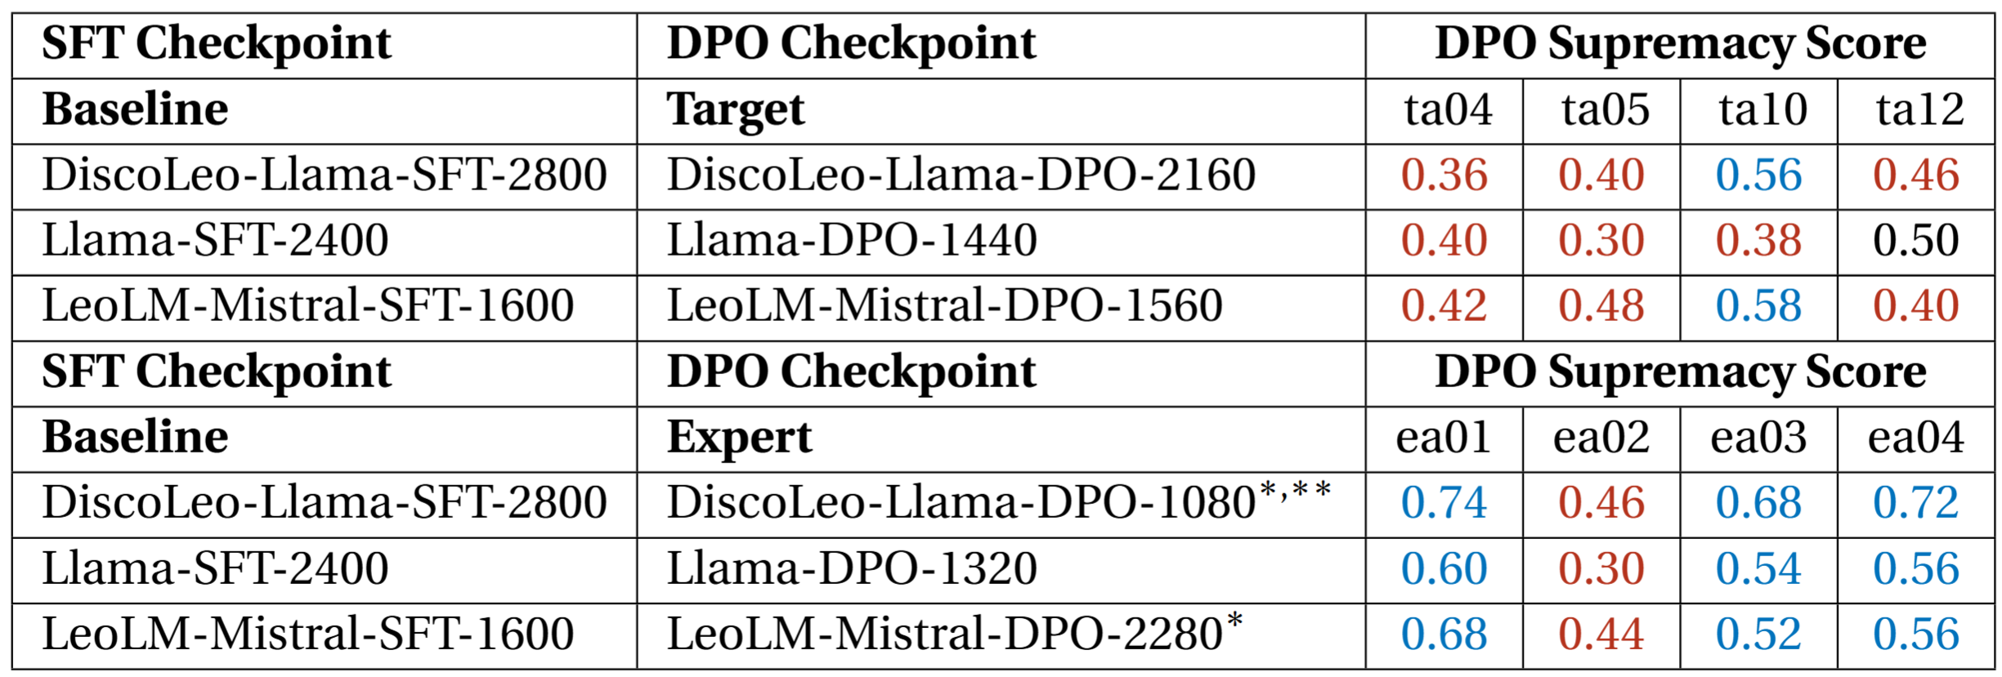
RQ3
Can DPO enable group-level personalization of ATS?
* DPO supremacy with ea02 data excluded
** DPO supremacy with ea02 data included
(group-level binomial tests with majority voting)
DPO can enable group-level personalization.
Outcomes are sensitive to preference consistency.

Slide 42
Future Work
Limitation: DEplain-APA
Create an alternative SFT dataset with (1) complex sentences above the B1 level and (2) entailment among all simplifications
Explore forgoing SFT
C: ‘Es gibt aber große Unterschiede.’
(en: But there are big differences)
S: ‘Nicht in jedem Vanille-Eis ist gleich viel Luft drin.’
(en: Not every vanilla ice cream contains the same amount of air.)

Slide 43
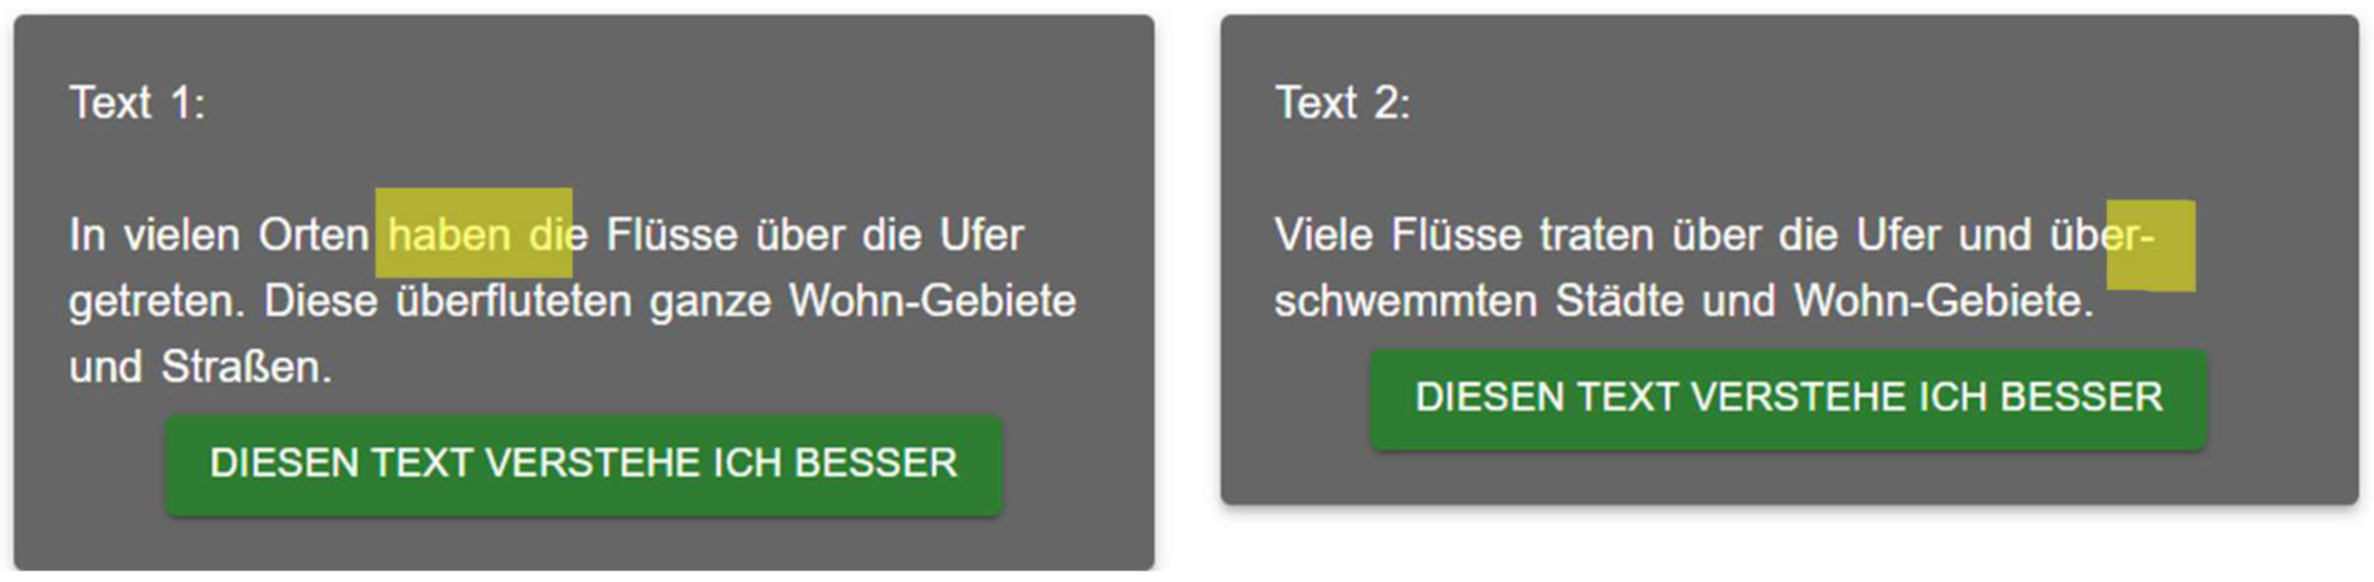
Future Work
Limitation: Pair quality & presentation
Create ATS pairs (rather than simplifications) directly
Use larger language models to generate inferences
Develop new HCI solutions for the target group

Slide 44
Future Work
(Possible) Limitation: DPO
Text:
HF4ATS means human feedback for automatic text simplification.
Investigate alternative preference alignment methods with this project’s dataset (HF4ATS)
Continue integrating target groups into the development process
I like this
I don’t like this

Slide 45
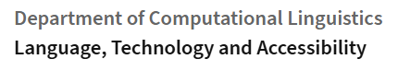

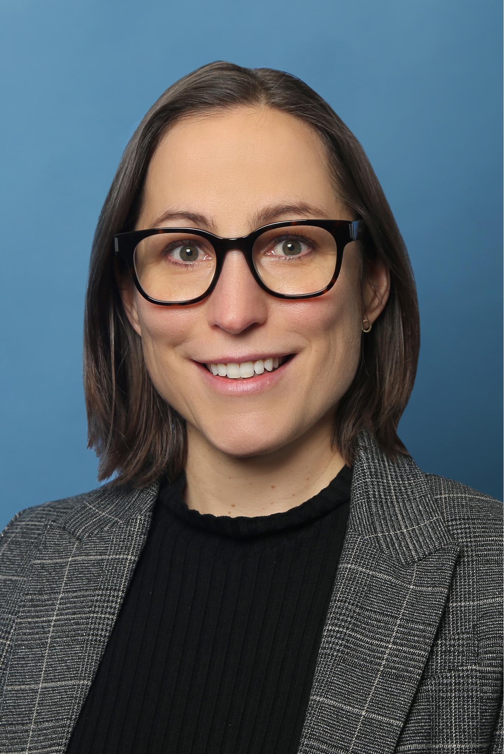
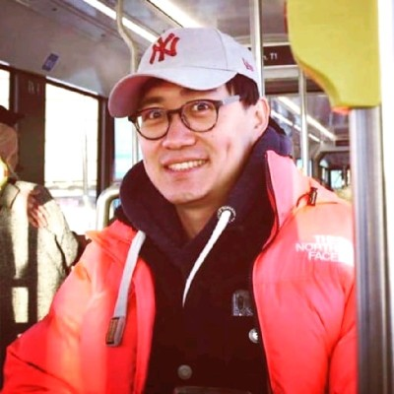
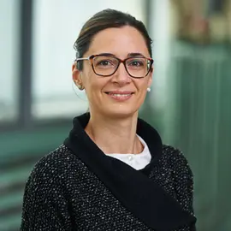

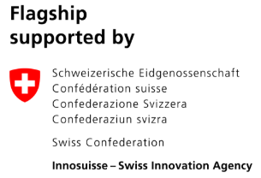


Thank you
Simplify this sentence: “All happy families are alike; each unhappy family is unhappy in its own way.”
Prof. Sarah Ebling
Dr. Yingqiang Gao
Luisa Carrer
David Froehlich

Slide 46
References
1. Rafailov, Rafael, et al. ”Direct preference optimization: Your language model is secretly a reward model.” Advances in Neural Information Processing Systems 36 (2024).

Slide 47
Appendix

Slide 48
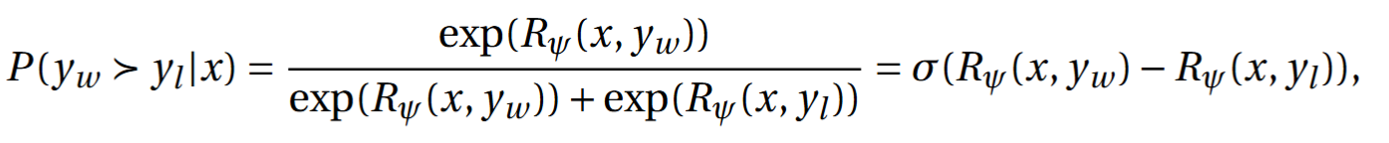
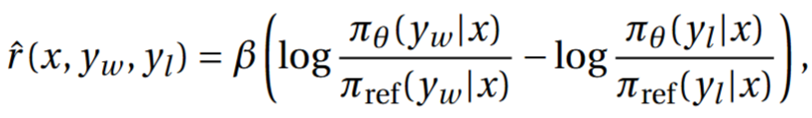

Slide 49
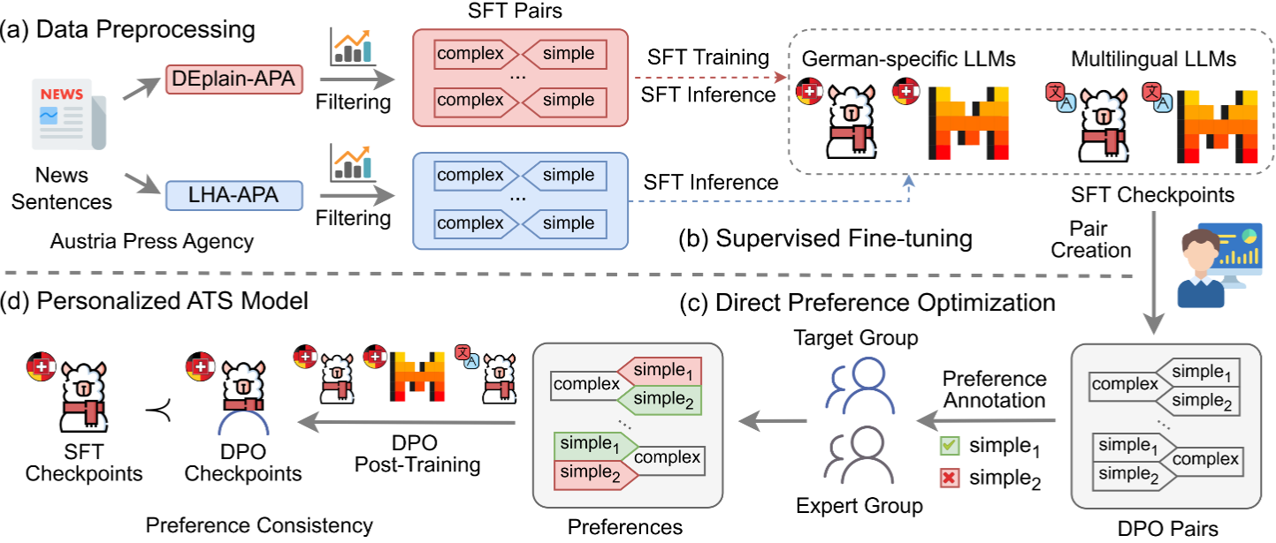

Slide 51
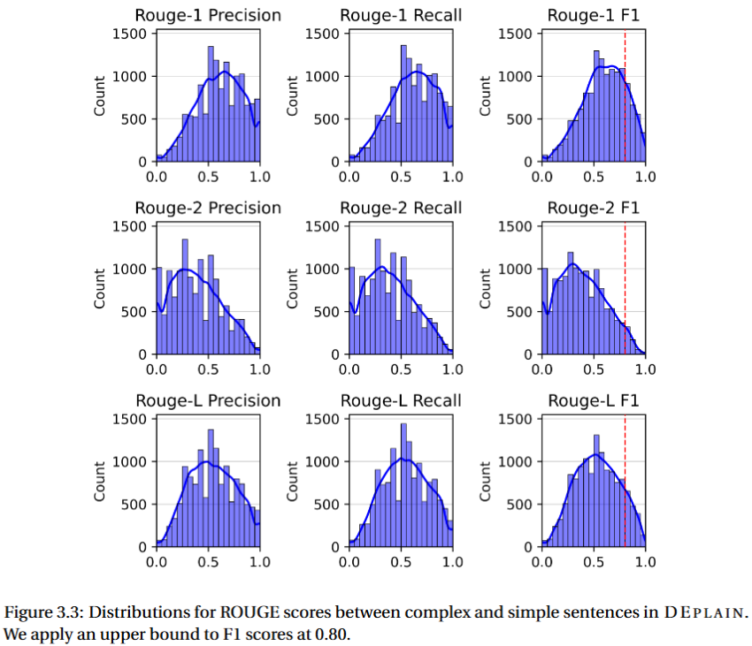
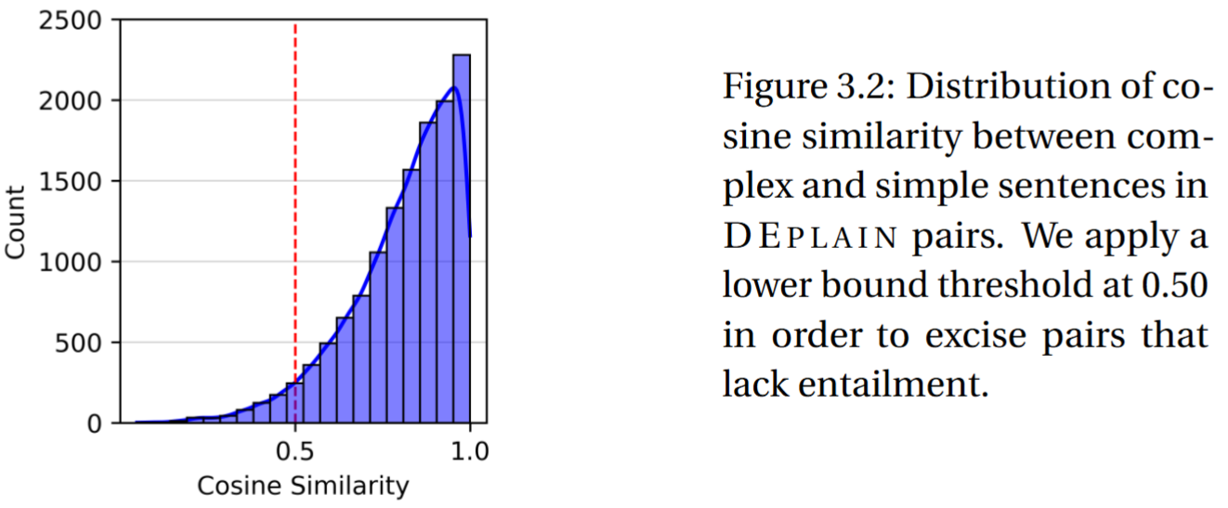

Slide 52
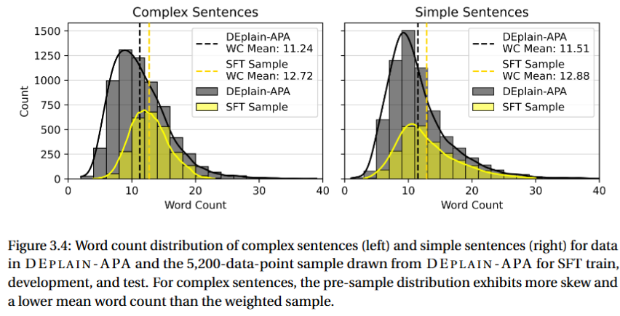
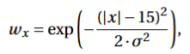

Slide 53
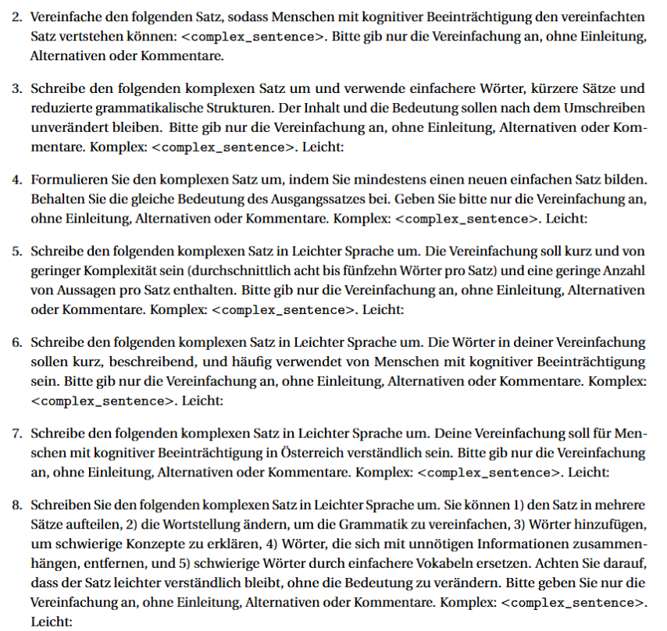
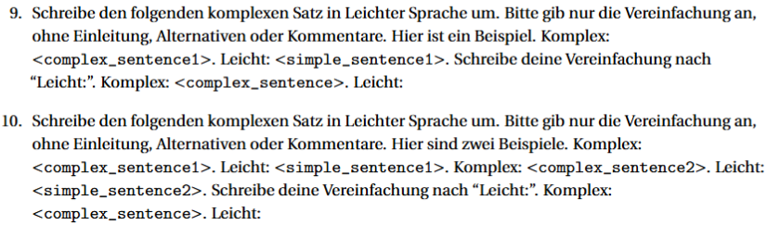

Slide 54
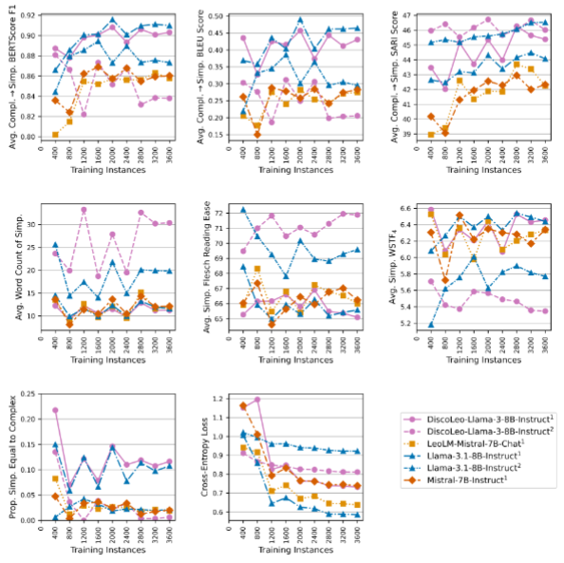

Slide 55
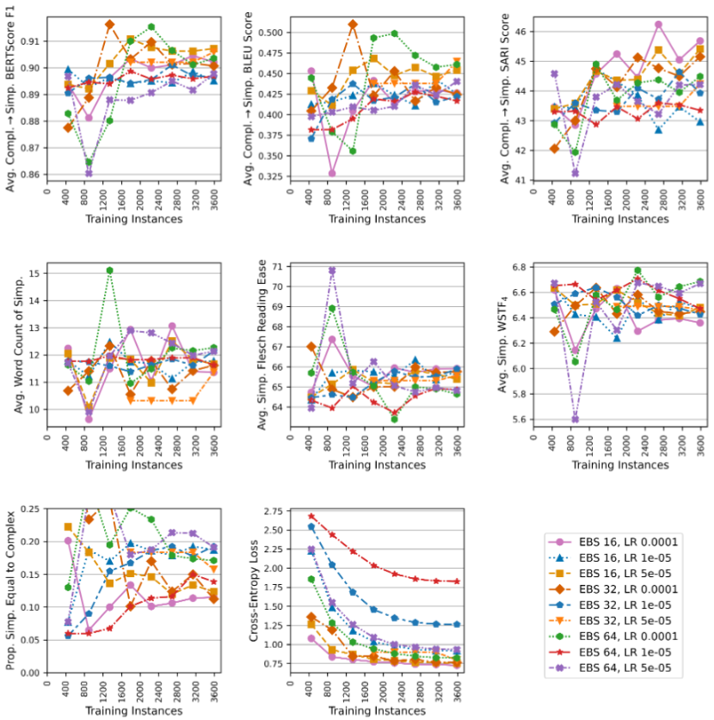

Slide 56
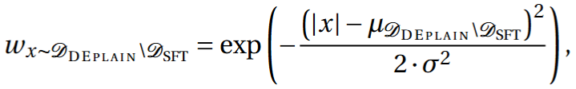
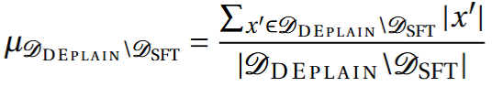
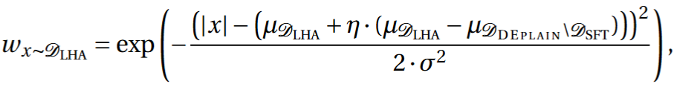
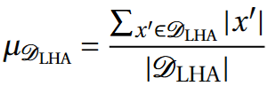

Slide 57
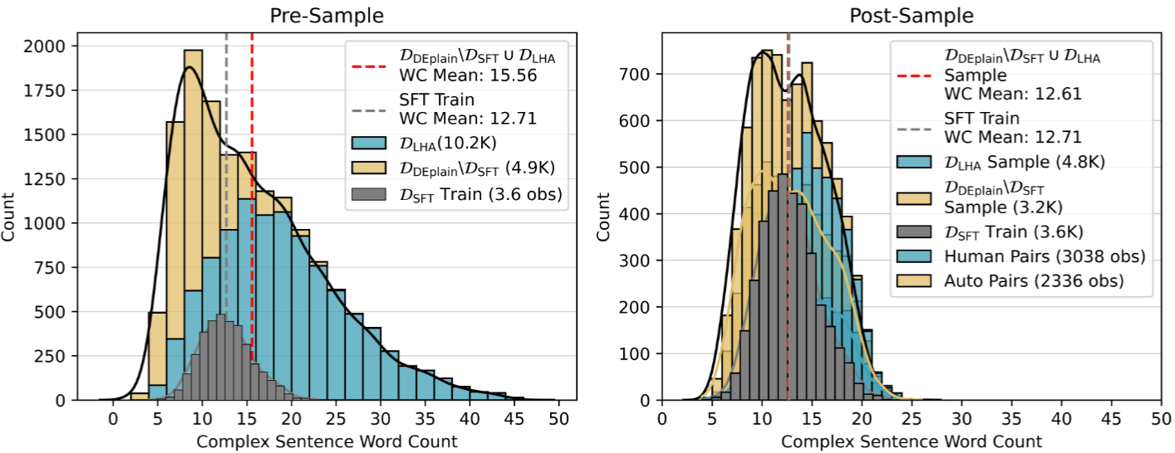

Slide 58
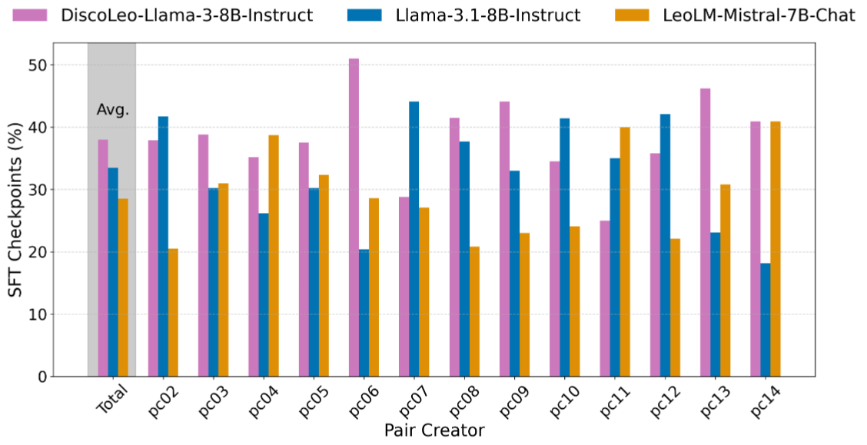

Slide 59
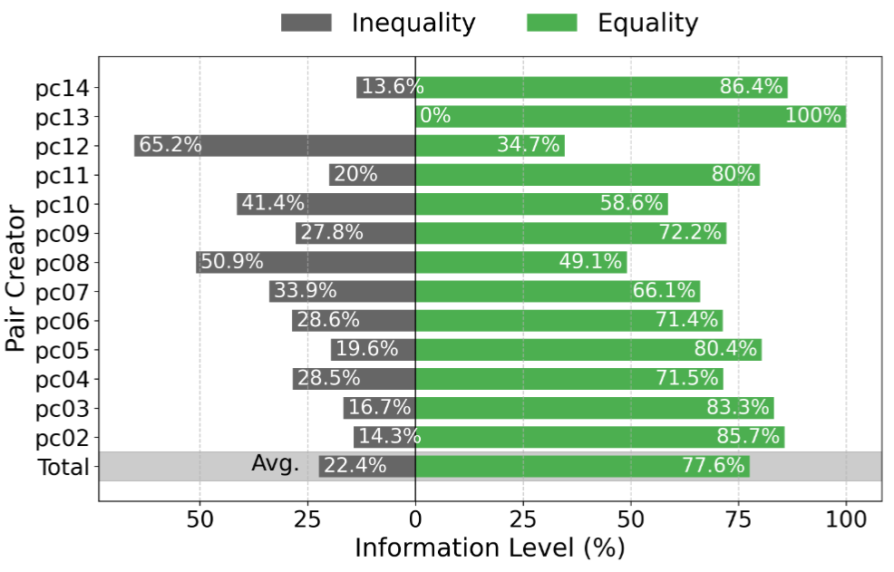

Slide 60
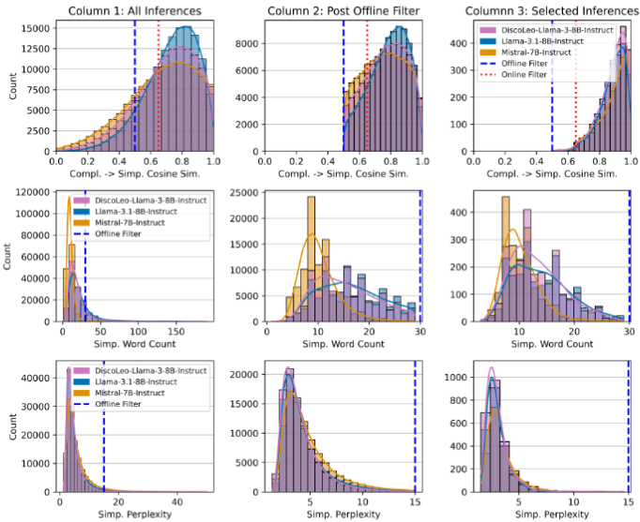

Slide 61
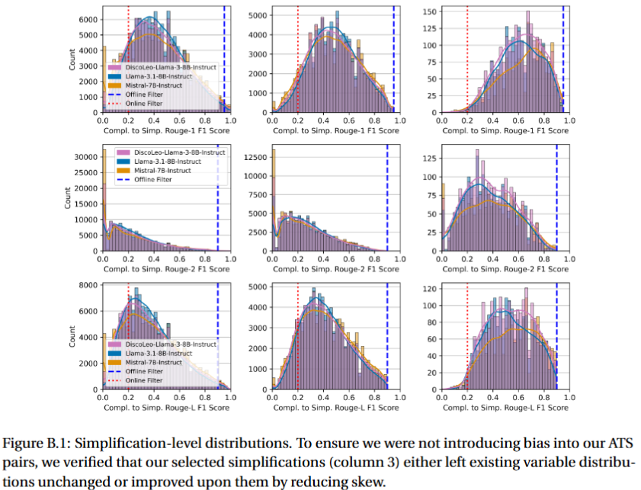

Slide 62
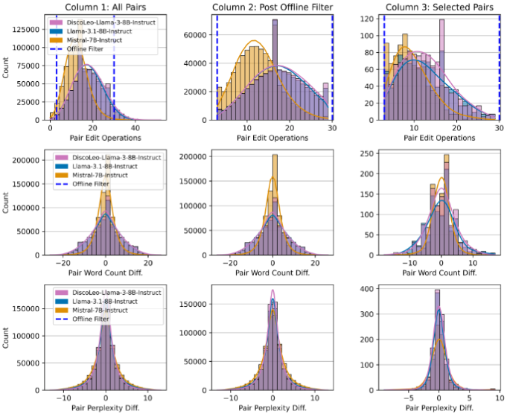

Slide 63
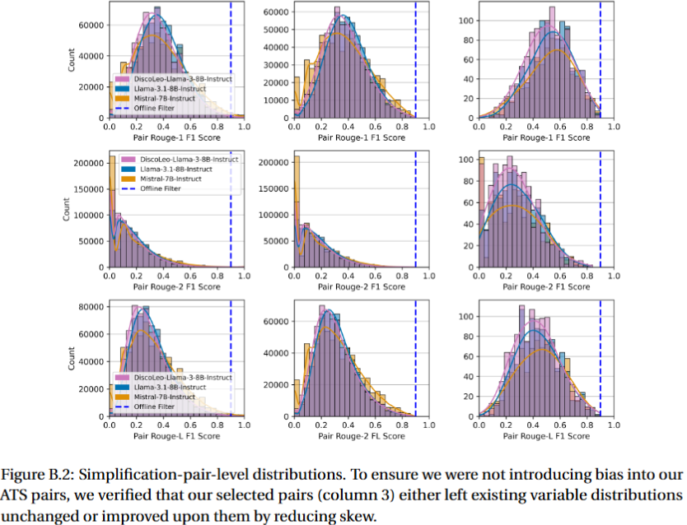

Slide 64
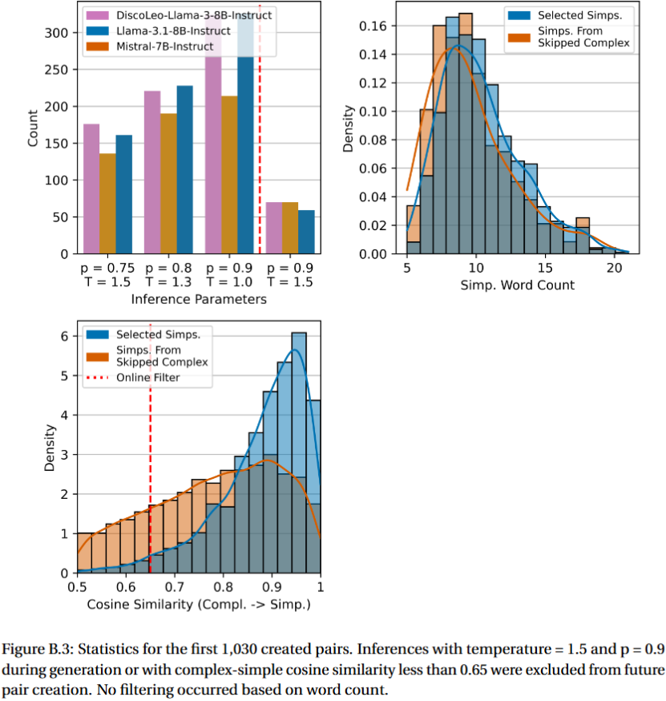

Slide 65
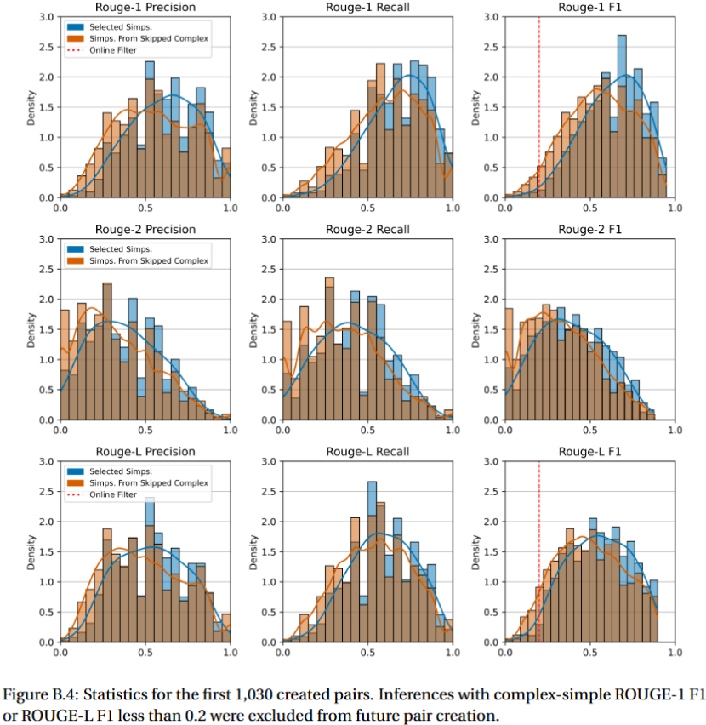

Slide 66
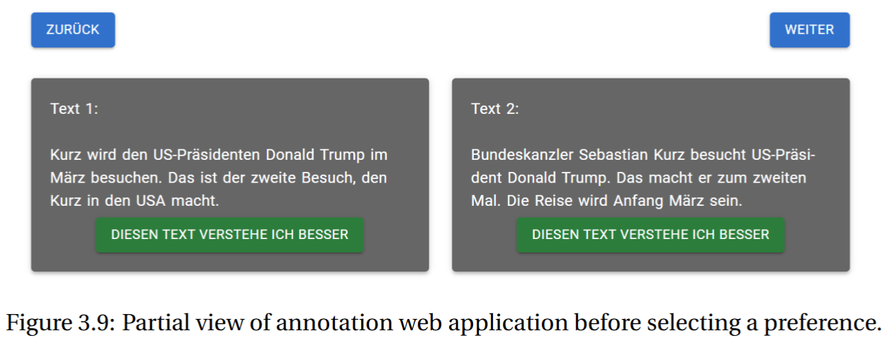

Slide 67
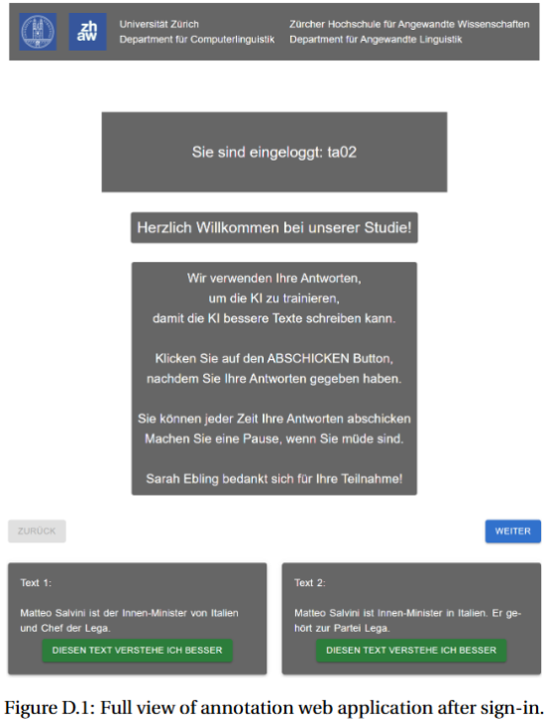
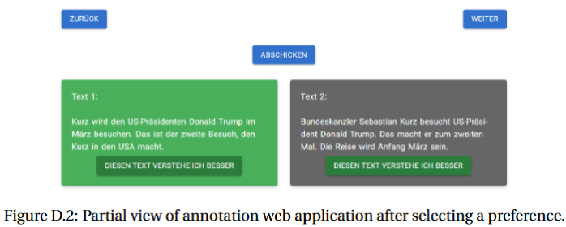


Slide 68



Slide 69



Slide 70


Slide 71


Slide 73


Slide 74


Slide 75


Slide 76


Slide 77


Slide 78


